Slide 1
SUBQUERIES AND DERIVED TABLES

Slide 2
Subqueries ● A subquery is a query contained within another SQL statement. ● A subquery is always enclosed within parentheses, and it is usually executed prior to the containing statement. ● Like any query, a subquery returns a result set that may consist of: A single row with a single column. Multiple rows with a single column. Multiple rows and columns.

Slide 3
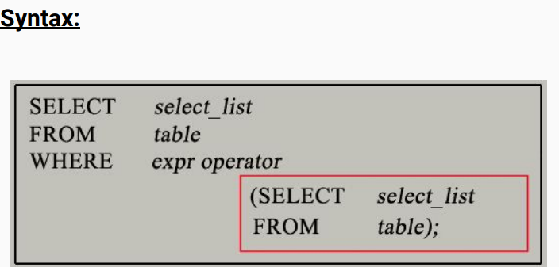
A subquery is usually added within the WHERE Clause of another SQL SELECT statement. You can use the comparison operators, such as >, < ,or =,IN ,ALL,ANY. A subquery is also called an inner query or inner select, while the statement containing a subquery is also called an outer query or outer select. The inner query executes first before its parent query so that the results of an inner query can be passed to the outer query SYNTAX:

Slide 4
Types of Subquery:
Scalar subqueries (Single-row)
● A scalar subquery is a subquery that returns a single value (ie. single row with one column).
● Mostly aggregate functions( COUNT,MIN,MAX,SUM,AVG) used in scalar subquery.
● This type of subquery is often used in conjunction with comparison operators such as = , >, >=, <,<= ,<> as these operators can compare a single value against the specific column in the comparison operation.

Slide 5
Multiple row subqueries (Multi-row)
It is a type of subquery that returns multiple rows of data.
Multi-row subqueries can return multiple rows that can be used as a set of values for comparison, filtering, or other operations in the outer query.
This type of subquery is often used in conjunction with operators such as IN, NOT IN, ANY, ALL. Because, here we have to deal with a list of values which will be returned by the multi-row subquery and the previous operators will not work here.
There are two types of multi-row subquery Subquery which returns multiple column and multiple rows. Subquery which returns only one column and multiple rows

Slide 6
Correlated subqueries ● A correlated subquery refers to one or more column from the outer query within its own query block. ● This establishes a dependency between the inner and outer queries, as the subquery is executed for each row processed by the outer query. ● It can be slower compared to other types of subqueries since they need to be executed multiple times, while the scalar and multi-row subqueries executed once and their results get assigned to the outer query. Nested Subqueries ● A Nested Subquery involves the embedding of one or more subqueries within another subquery. ● The nesting can be extended to accommodate various levels of complexity. However, excessive nesting can reduce readability and performance.

Slide 7
Derived Tables in MySQL
A derived table in MySQL is a temporary table created from a SELECT statement, which exists only for the duration of the query in which it is used. Derived tables allow you to create subqueries within the FROM clause, enabling you to organize and manipulate data more effectively in a single query.
Syntax
SELECT column1, column2 FROM ( SELECT columnA, columnB FROM table_name WHERE condition ) AS derived_table_name WHERE another_condition;

Slide 8
Conclusion
In MySQL, subqueries and derived tables are powerful tools for managing complex queries by allowing data manipulation and filtering within the same SQL statement. Subqueries are nested queries used within SELECT, FROM, or WHERE clauses to perform operations like filtering, aggregating, or calculating values dynamically. Derived tables, a type of subquery placed in the FROM clause, act as temporary tables for the duration of the query, enabling the organization of intermediate results and simplifying query logic. While both approaches enhance query modularity and readability, derived tables are particularly useful for breaking down complex aggregations or multi-step transformations. However, care must be taken with performance, as subqueries and derived tables may lack indexing, impacting execution time for large datasets.

Slide 9
thank you thahliyamist@gmail.com

